Slide 1

EMB-101: Emergence of Bangladesh Class -4
British India:1858-1911

Slide 2
British India:1858-1911
Topics to be covered:
The Aftermath of the first war of independence (1857)
Rise of nationalism and change in the British policy
First partition of Bengal in 1905
Swadeshi movement
Electoral and administrative reforms

Slide 3
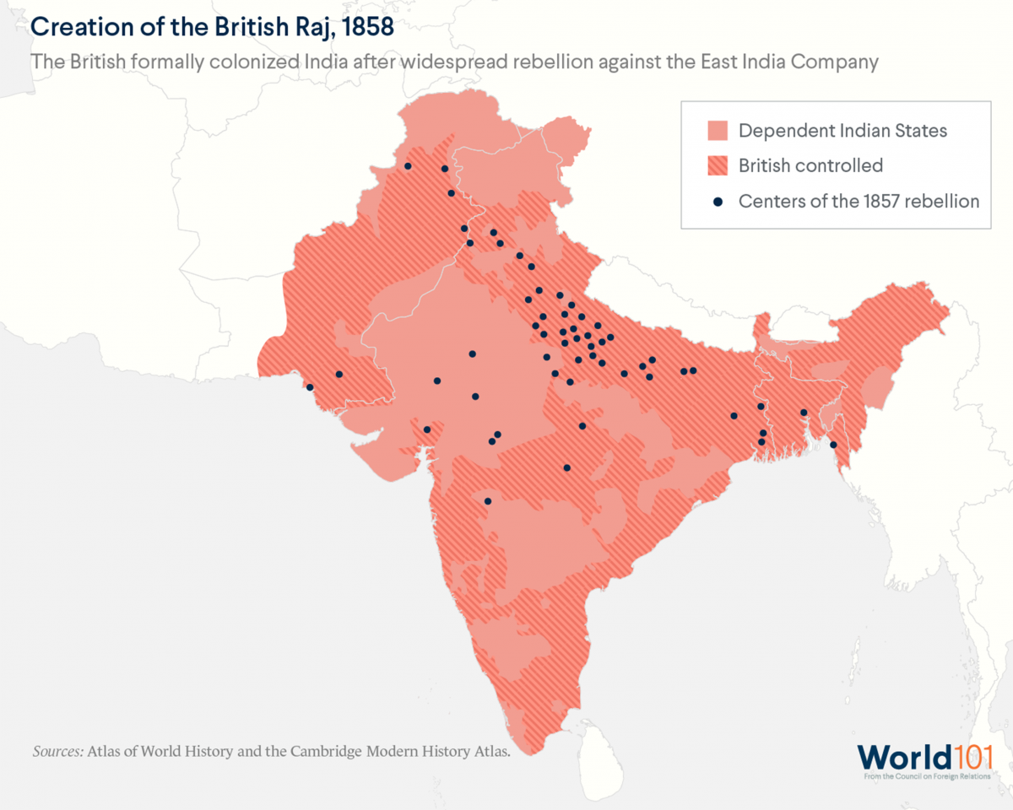
Crown Rule, 1858
The British Crown took over the rule of colonial India and abolished the East India Company

Slide 4
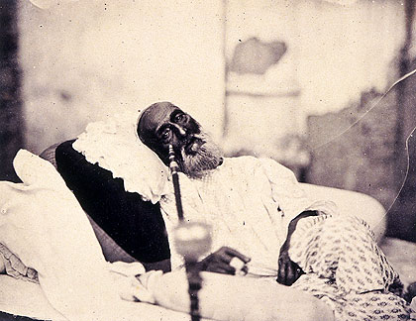
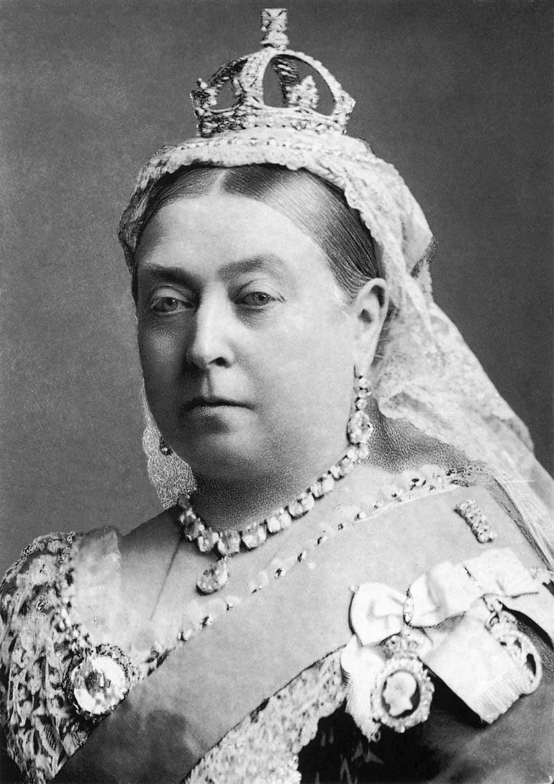
The Empire in Transition
Bahadur Shah Zafar in 1858, just after his trial in Delhi and before his departure for exile in Rangoon. This is possibly the only photograph ever taken of a Mughal emperor.
Queen Victoria became the Empress of India

Slide 5

RISE OF THE ‘MIDDLE-CLASS’, RELIGIOUS REVIVALISM (1/2)
Reactions:
The increasing numbers of primarily upper-caste Hindus in the professional and commercial classes and education, including immersion in Western Science leads to abandonment of traditional religious and cultural practices
This leads to a reaction that becomes known as religious revivalism
Increasingly, many revivalists insist on focusing solely on Hindu Scriptures and ironically viewing Hinduism through a monotheistic prism as preferred by the Raj
Organizations that had previously focused on social reform now begin to take up causes and projects that create friction between the religiously faithful; particularly Hindus and Muslims

Slide 6
RISE OF THE ‘MIDDLE-CLASS’, : RELIGIOUS REVIVALISM (2/2)
Revivalism leads to an idealization of the past; which in most instances was imaginary
In attempting to reimagine a perfect past; revivalists end up taking positions on social and cultural issues that are reactionary and obscurantist.
A lot of the open-ended folk traditions of Hinduism are ignored or discarded.
There is also a focus on winning back converts to Islam, Christianity and Sikhism

Slide 7

THE RISE OF THE ‘MIDDLE-CLASS’, COMMUNAL CONFLICTS
The rise of Cow Protection Societies in the 1870s leads to increasing confrontations with those involved in the butcher’s trade, Muslims and lower-caste Hindus
In 1888 a Raj imperial court rejects the sanctity of the Cow
1893: the first of the Hindu-Muslim Communal Riots over the issue takes place
Well-off Muslims, previously untouched by the question of cow meat, become mobilized
Muslim participation in Congress begins to drop after 1893
Communalism: the perspective of viewing and treating people who are not one’s co-religionists with discrimination, prejudice and hostility

Slide 8
THE RISE OF THE ‘MIDDLE-CLASS’, REFORMS & NATIONALISM
In the Bombay region, revivalist festivals such as the celebration of Ganapati, the Elephant-Headed God, which had previously welcomed Muslims, becomes exclusive
The reverence of Shivaji, the most charismatic of Maratha leaders, gradually takes an anti-Muslim slant
The pluralism or non-religious nature of Ishwar Chandra Vidyasagar is replaced by more hard-edged personalities such as Bankim Chandra Chattopadhyay, one of the leading innovators of the modern Bengali novel, who makes unsympathetic pronouncements about Muslims

Slide 9
THE RISE OF THE ‘MIDDLE-CLASS’, GROWTH OF MUSLIM SEPARATISM
Since Plassey Muslims across the Indian subcontinent had witnessed a loss of privileges and positions with the collapse of Mughal Delhi and then the regional Muslim powers
There was a great disinterest amongst Muslims in interacting with the colonial power or undertaking educational or other opportunities
The situation begins to change with the initial efforts of Syed Ahmed Khan who established Aligarh College in the 1870s
Syed Ahmed Khan exhorted Muslims to embrace modern education and to accept the overlordship of the British Raj
Notes:
will go up

Slide 10
THE RISE OF THE ‘MIDDLE-CLASS’, REFORMS & NATIONALISM MUSLIM AWAKENING
In Bengal, Muslim disinterest is greater
For example; an early mid-19th century college created by a Bengali Muslim beneficiary primarily with his co-religionists in mind has less than a handful of Bengali Muslims a decade later (Hooghly College)
Nevertheless, there is a realization amongst conscious Bengali Muslims that they are falling behind their Bengali Hindu brethren
Abdul Latif – Muhammadan Literary Society (1863)
Syed Amir Ali – Muhammadan National Association (1878)

Slide 11
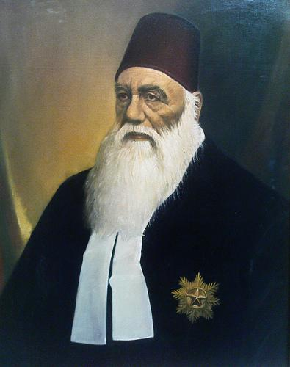
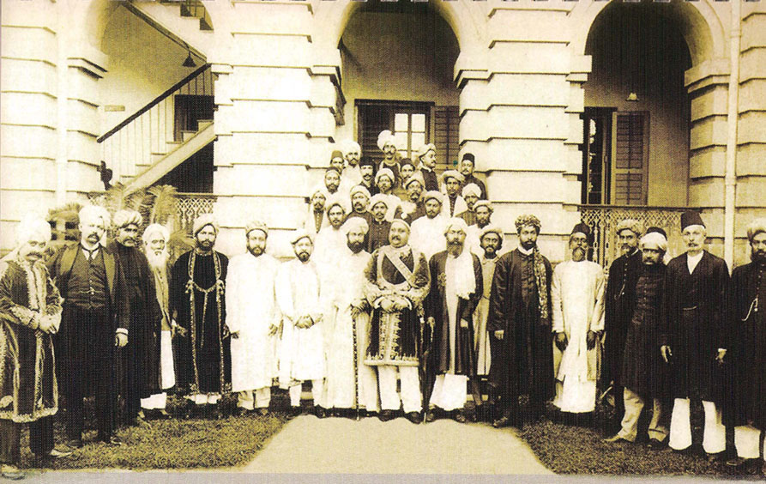
Muslim awakening
SIR SYED AHMAD KHAN
Nawab Salimullah with local elites

Slide 12
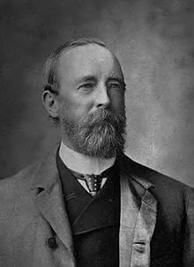
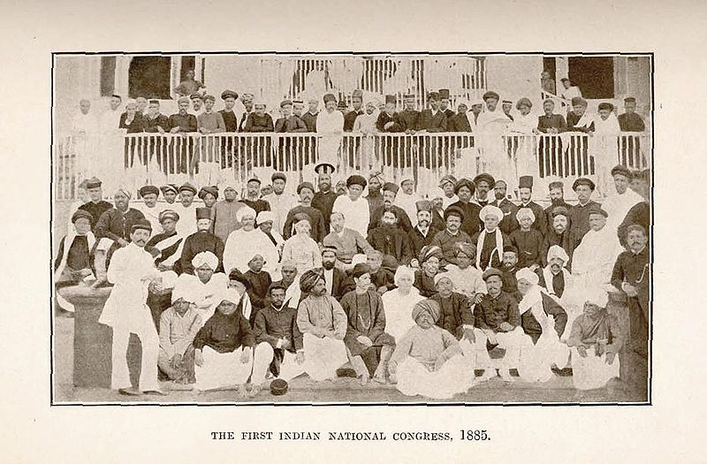
Nationalism and the rising demand for participatory politics
Indian Councils Act 1861
Indian Councils Act 1892
Allan Octavian Hume
1st Indian National Congress, 1885

Slide 13
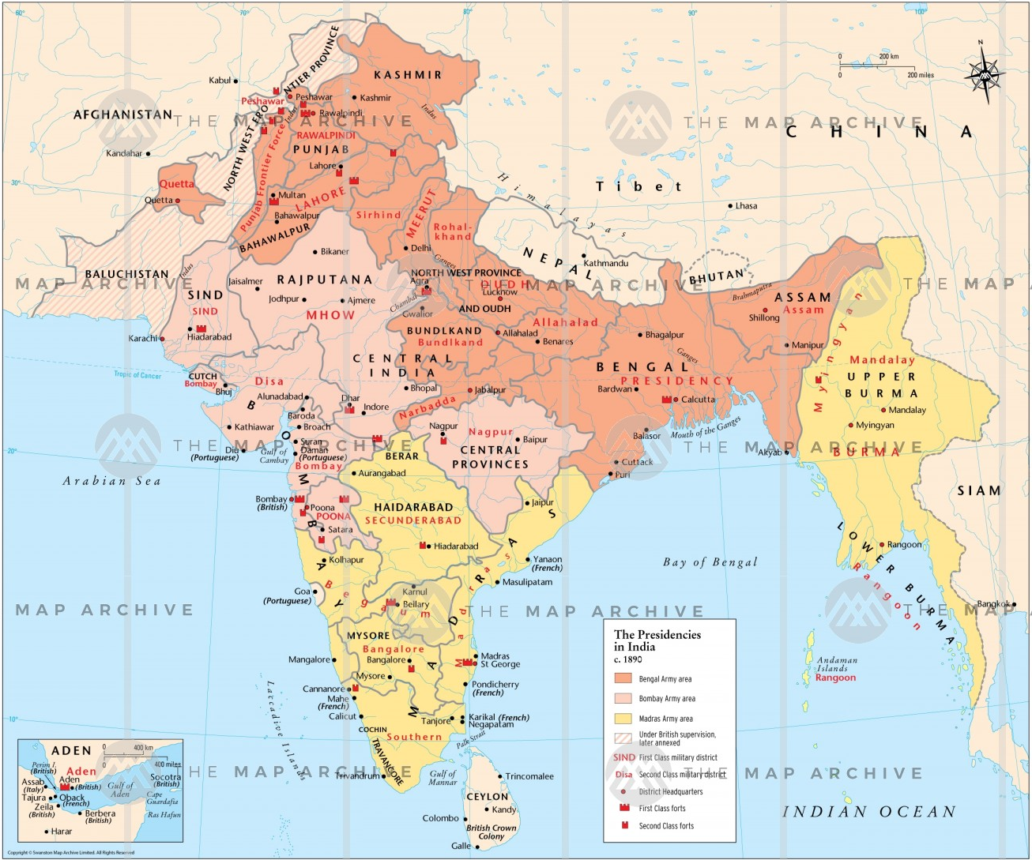
The Presidencies in India c.1890
Bengal Presidency
Madras Presidency
Bombay Presidency

Slide 14
First Partition of Bengal: 1905
Lord Curzon, Viceroy of India 1899-1905) enacted the partition of Bengal
October 16, 1905
Eastern province (East Bengal and Assam) with Muslim majority
Western province (West Bengal, Bihar and Orissa) with Hindu majority

Slide 15
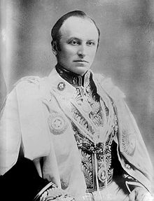
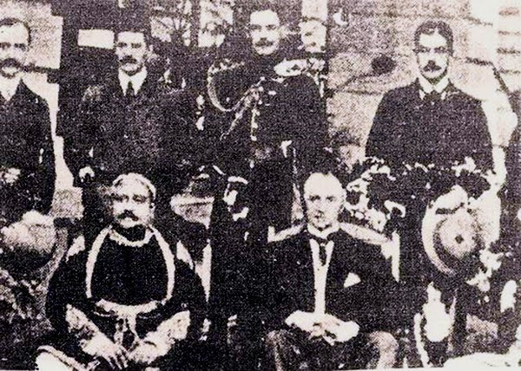
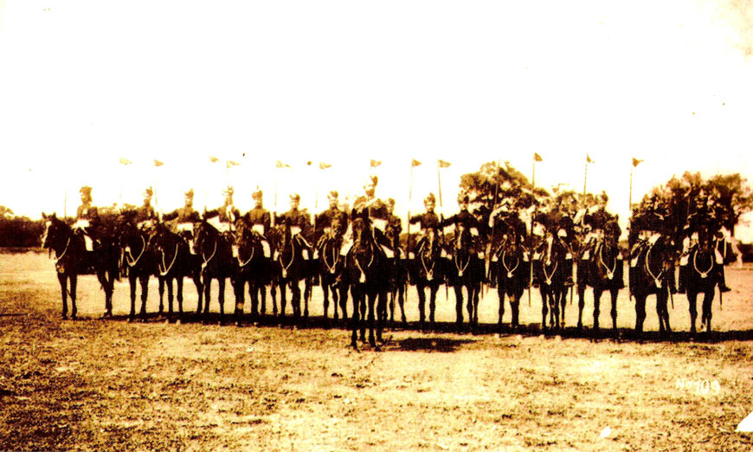
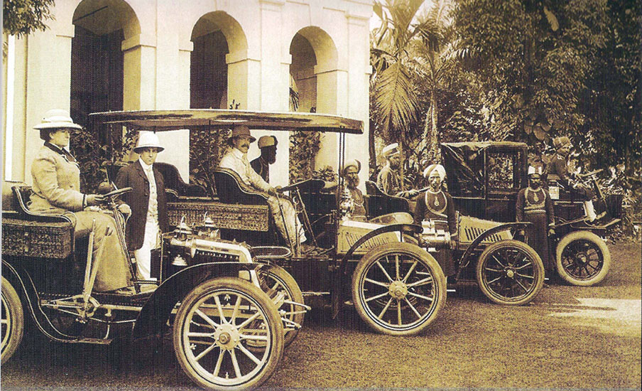
First Partition of Bengal: 1905
Curzon in Dacca
Lord Curzon
Lord Curzon with Nawab Sir Salimullah in Ahsan Manzil ,1904
Viceroy Curzon's Escort at Dacca in 1904
In 1904, Lord Curzon at Shahbagh, Dhaka

Slide 16
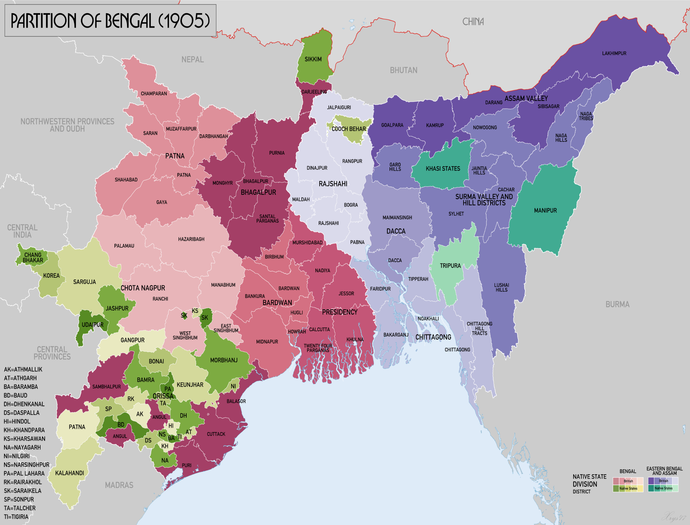
THE PARTITION OF BENGAL
1904: In a letter to the Secretary of State for India in London, Raj official Herbert Risley wrote: “Bengal united is a power. Bengal divided will pull in several different ways. That is perfectly true and is one of the merits of the scheme.”
Bengali Muslims are promised resources, institutions and influence by the Viceroy and other Raj officials
A Muslim-majority East Bengal & Assam is detached from Bengal
While Partition is officially announced on October 16, 1905 an anti-Partition Movement has been forming since 1903

Slide 17
THE SWADESHI MOVEMENT: FEATURES
Four interlinked phases, a moderate phase, constructive, political agitation and revolutionary terrorism
From the beginning the movement is fractured; a number of landlords oppose the movement, very few Muslims join, only a few of note
The inability of the moderates, through letters and petitions, fails to move the Raj
The next stage of the movement calls for a boycott of British and foreign goods, the making of Swadeshi or indigenous products

Slide 18
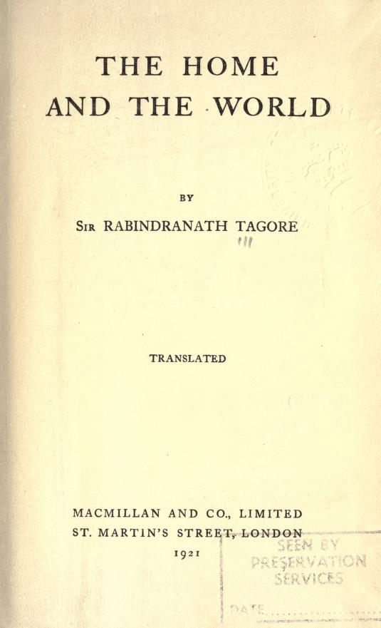
THE SWADESHI MOVEMENT: PROBLEMS AND CONTRADICTIONS (1/ 2)
The boycott is not effective; indigenous substitutes are more expensive and shoddier, compared to cheaper and quality British and foreign goods
Tagore, in Home and the World, discussed the problems and contradictions inherent within the movement
Tagore focuses on constructive Swadeshi, establishing Santiniketan (‘the abode of peace’)
National Schools
Swadeshi arbitration courts
Tagore and other elite and upper-class leaders either withdraw from the movement or remain focused on constructive Swadeshi activities

Slide 19

THE SWADESHI MOVEMENT: PROBLEMS AND CONTRADICTIONS (2/2)
Tagore had called for better relations between the Swadeshi Movement and farmers, peasants and urban workers
However, these do not materialize and farmers, shopkeepers and workers are not convinced by the anti-Partition Movement
Additionally, the Movement uses religious motifs, imagery and exhortations to galvanize support but this alienates Muslims and lower-caste Hindus
As elite leaders leave, radical middle-class personalities take up the leadership

Slide 20
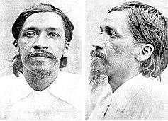
REVOLUTIONARY ACTS:
The objective of the Swadeshi Movement is no longer reversal of Partition but Swaraj or full independence and expulsion of the Raj
Secret revolutionary societies
Anushilan Samiti
Revolutionary activities are on the rise; already during 1905-1907 revolutionaries have targeted collaborators and spies
Revolutionary groups had attempted to effect assassination plans against Fraser, lieutenant-governor of Bengal, and Fuller, lieutenant-governor of East Bengal & Assam
Aurobindo Ghose)

Slide 21
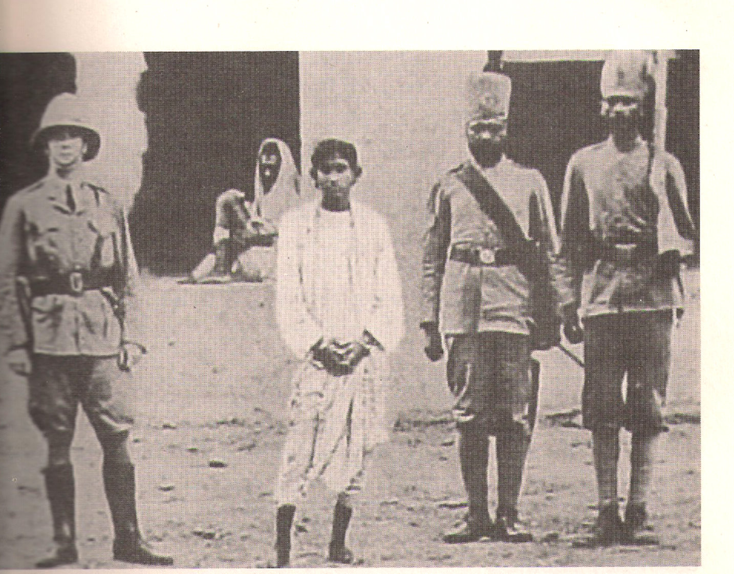
ARMED ANTI-COLONIAL MOVEMENT:
‘Jugantar’ (‘New Era’)
April 30, 1908: Two New Era revolutionaries, Khudiram Bose and Prafulla Chaki throw a bomb at a carriage they believed was carrying a notorious Raj official
The bombing stuns the Raj and ignites the armed revolutionary struggle within the subcontinent that will continue in different forms until 1938 and during 1942-1943
The martyrdom of Khudiram and Prafulla reinvigorates the militant anti-colonial movement

Slide 22
একবার বিদায় দে মা ঘুরে আসি পীতাম্বর দাস (Pitambar Das)
একবার বিদায় দে মা ঘুরে আসি। হাসি হাসি পরব ফাঁসি দেখবে ভারতবাসী। কলের বোমা তৈরি করে দাঁড়িয়েছিলাম রাস্তার ধারে মাগো, বড়লাটকে মারতে গিয়ে মারলাম আরেক ইংলন্ডবাসী। হাতে যদি থাকতো ছোরা তোর ক্ষুদি কি পড়তো ধরা মাগো রক্ত-মাংস এক করিতাম দেখতো জগতবাসী
শনিবার বেলা দশটার পরে জজকোর্টেতে লোক না ধরে মাগো হল অভিরামের দ্বীপচালান মা ক্ষুদিরামের ফাঁসি বারো লক্ষ তেত্রিশ কোটি রইলো মা তোর বেটা বেটি মাগো তাদের নিয়ে ঘর করিস মা মোদের করিস দাসী দশ মাস দশদিন পরে জন্ম নেব মাসির ঘরে মাগো তখন যদি না চিনতে পারিস দেখবি গলায় ফাঁসি।

Slide 23
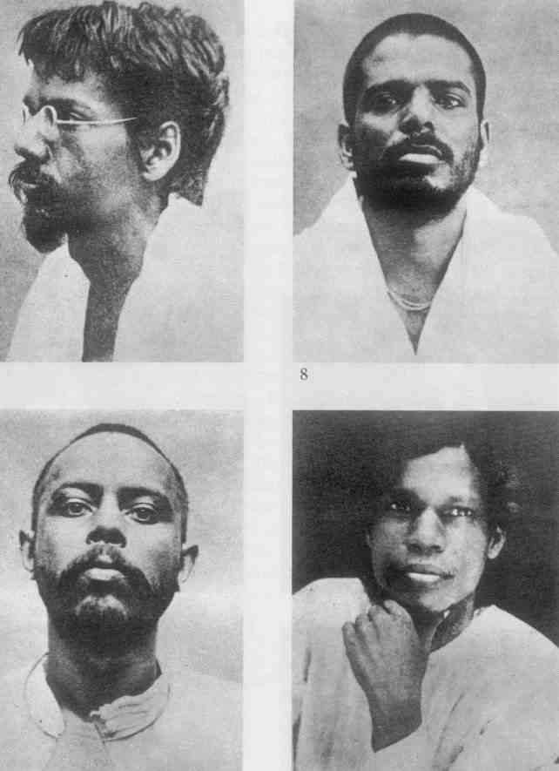
Barindra Kumar Ghose
Upendranath Banerjee
Ullaskar Dutt
Hem Chandra Das
Notes:
Ullaskar Dutt

Slide 24
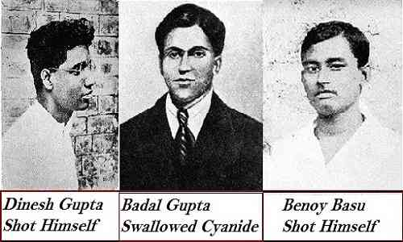
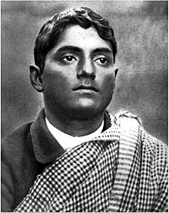
Jatindranath Mukherjee
(Bagha Jatin)

Slide 25
THE PARTITION OF BENGAL: ANTI-COLONIAL STRUGGLES
In the short term, the first New Era group is destroyed by the Raj
1907: Aurobindo Ghose and other militant leaders try to wrest control of the Indian National Congress but fail
1908: The Indian National Congress categorically rejects the Swadeshi Movement
Congress loses its popularity; and will remain at odds with the wishes of a populace who wanted a more dynamic approach to the anti-colonial struggle

Slide 26
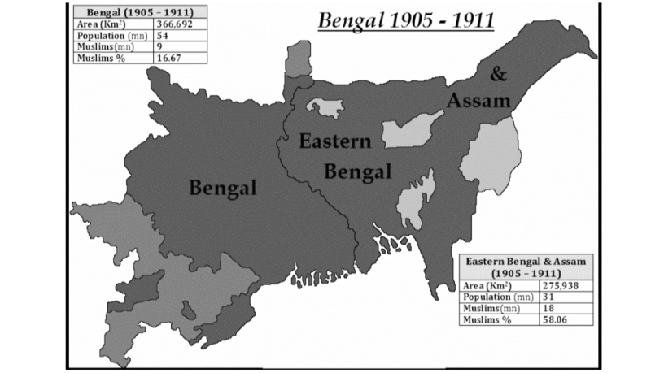
THE PARTITION ANNULMENT
Unexpectedly, despite having defeated all the phases of the Swadeshi Movement the Raj announces the reversal of the Partition in 1911
Morley, the Secretary of State for India and Kynynmound, the Viceroy, institute the so-called Government of India Act of 1909:
The Act promises the right to franchise and principle of elections; very vague, narrow and restrictive
The Raj assured its masters in London, speaking of the Act and the concessions: “…we anticipate that the aristocratic element in society and the moderate men…will oppose…any attempt to democratize…”

Slide 27
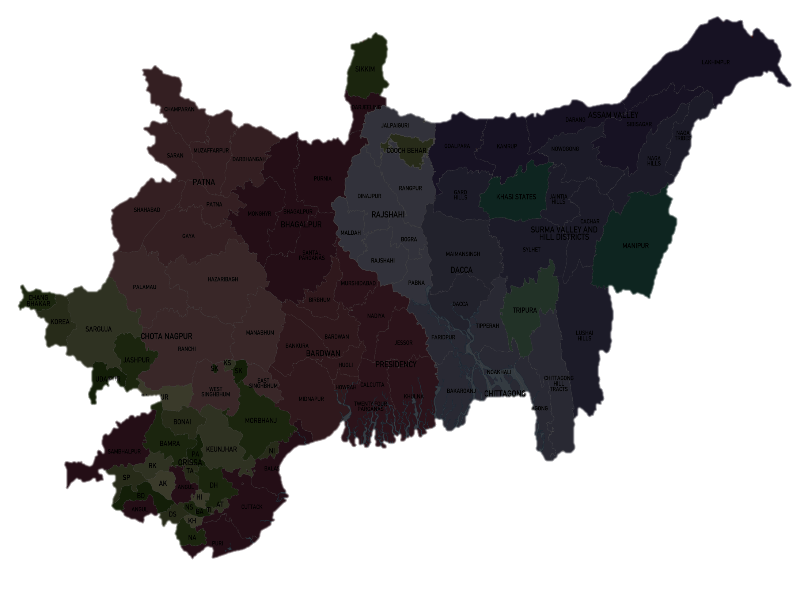
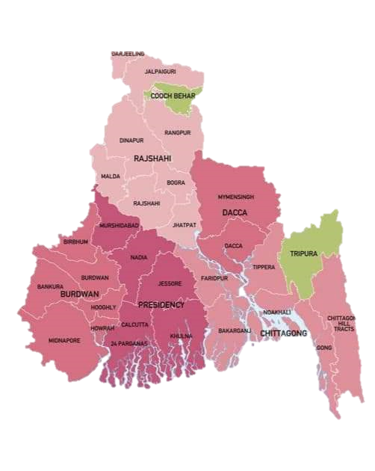
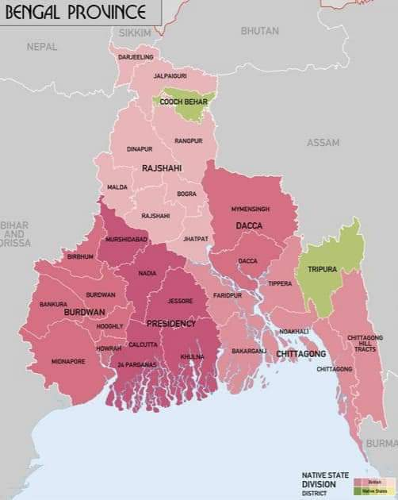
Comparative Picture of Bengal Before 1905 and after 1911
Bengal Presidency
Bengal Province after the Annulment

Slide 28
BENGAL's COMMUNALISM
27 seats are now opened in the Imperial Legislative Council; 8 are to be reserved for Muslims
The introduction of separate electorates; this will further engender communalism in the coming years
Communal tensions which had flared up during the Swadeshi Movement remain unresolved
Bengal loses her importance in the subcontinent with the shift of the Raj capital to Delhi in the North

Slide 29
Suggested Readings
Bose, Sugata & Jalal, Ayesha, Modern South Asia: History, Culture, Political Economy (New York and London: Routledge, 2004)
Bandyopadhyay, Sekhar, From Plassey to Partition: A History of Modern India (New Delhi: Orient Longman, 2004)
Schendel, Willem Van, A History of Bangladesh (New York: Cambridge University Press, 2009)
Metcalf, Barbara D. &amp; Metcalf, Thomas R., A Concise History of Modern India (Cambridge:Cambridge University Press, 2006)
Sarkar, Sumit, Modern India: 1885-1947 (New Delhi: Pearson, 2014)

Slide 30
?

Slide 31
Topics for the next classes
Class 5: Introduction to book review
Class 6: British India: 1912-1947

